Slide 1
A Tale of Two Stories
Brad Cross
11/19/14
Based on Joel Spolksy’s “Two Stories” from Joel On Software

Slide 2
Overview
Company comparisons
Joel Spolsky’s two experiences
Company management
Trusting your employees
Voicing an opinion as an employee

Slide 3
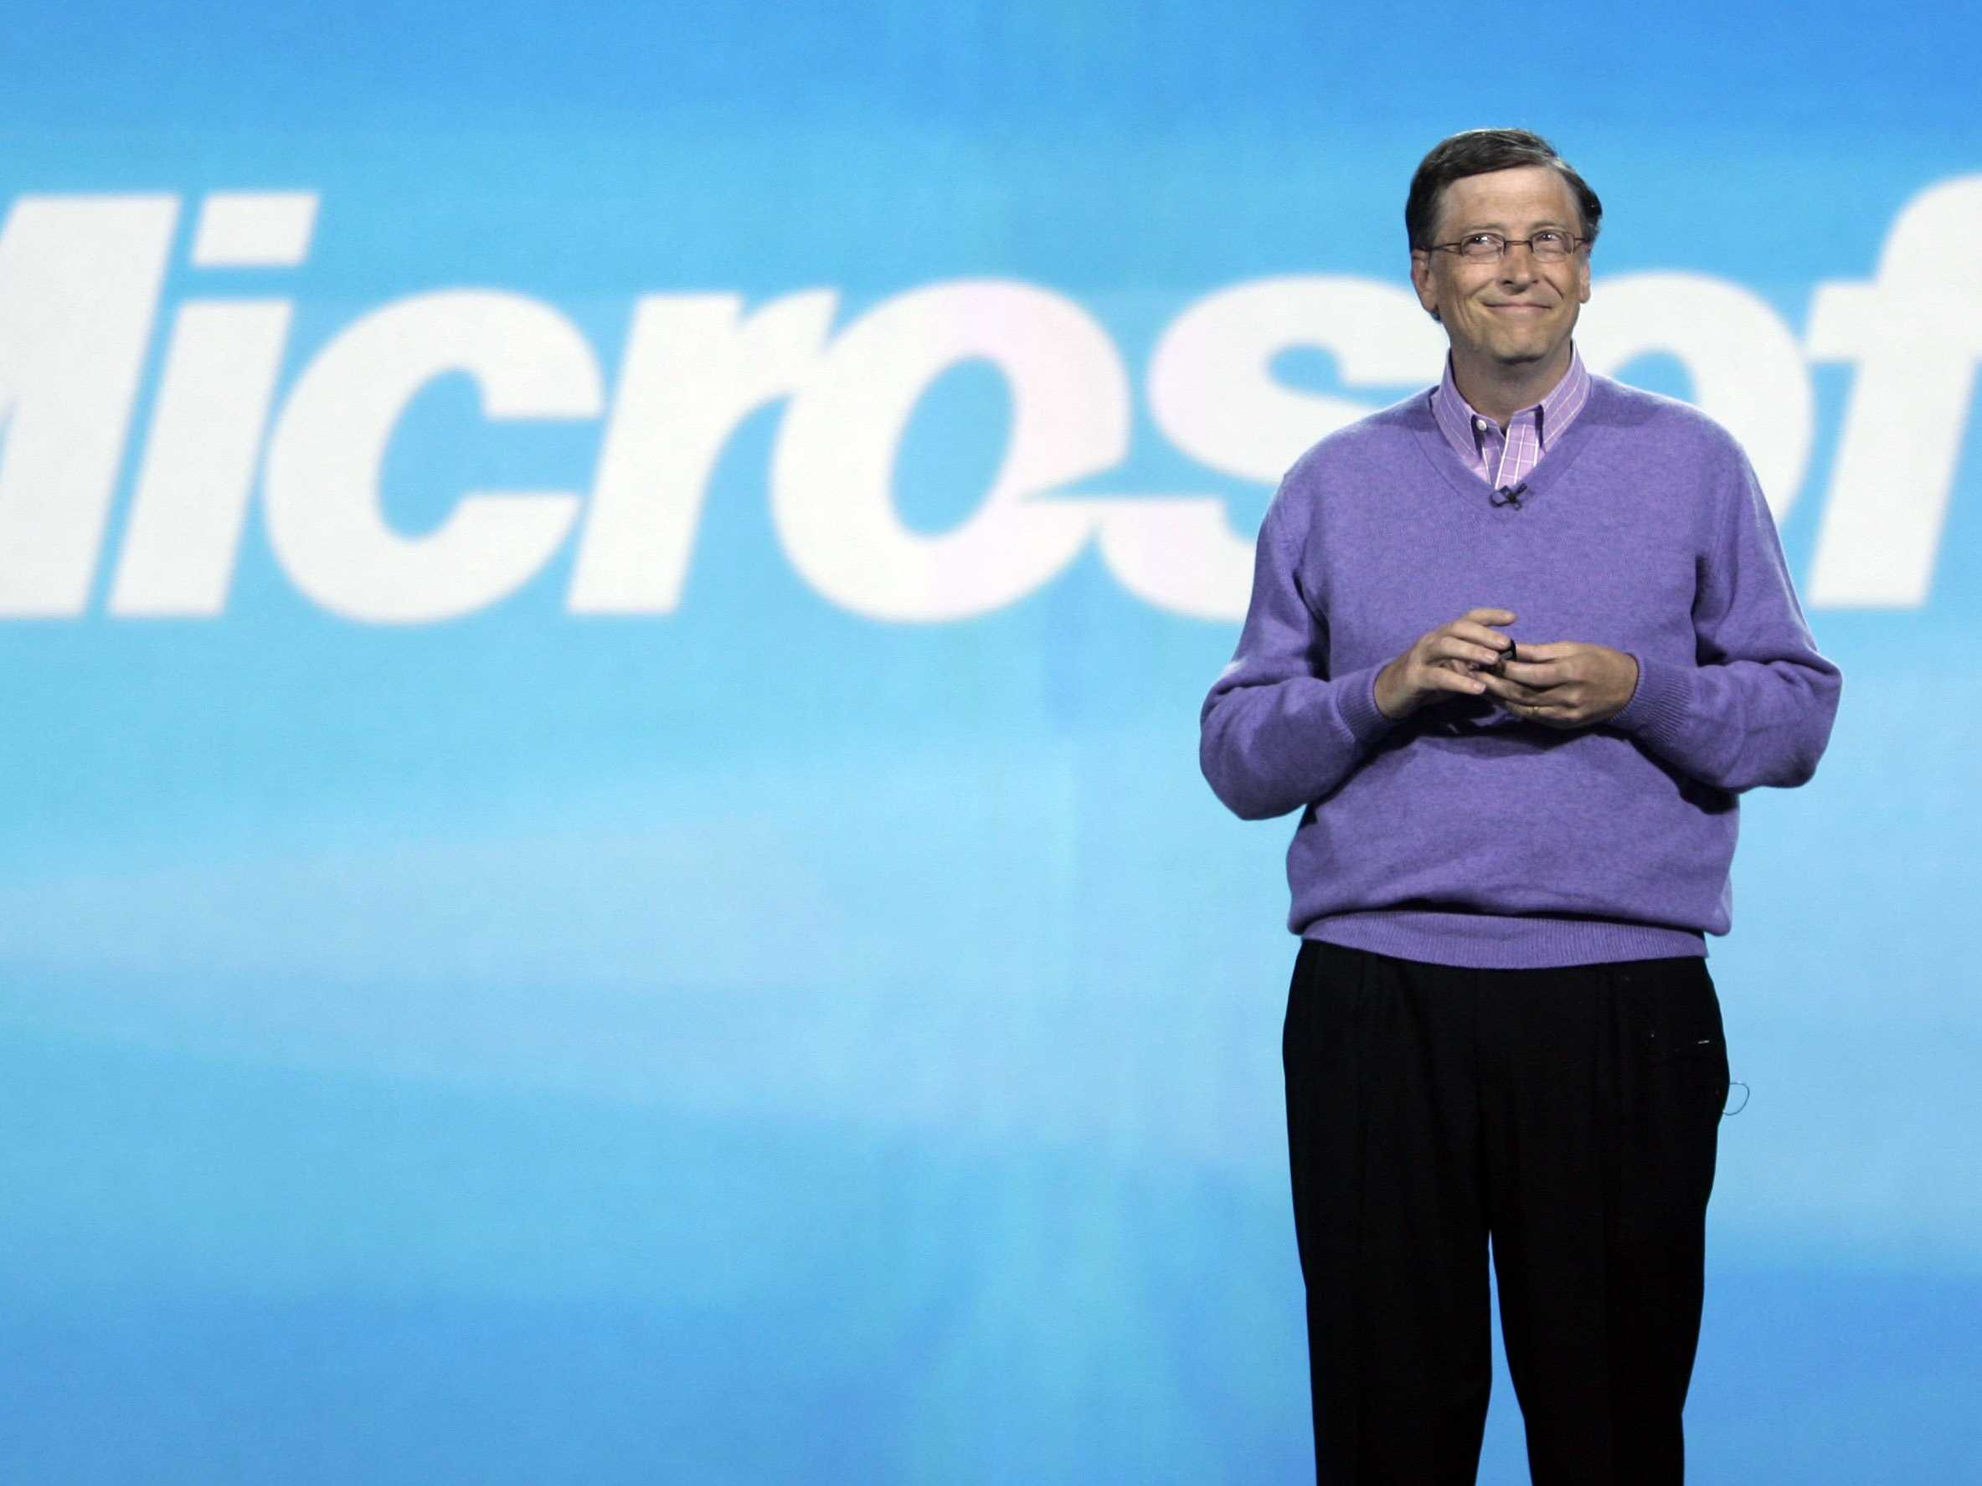
The Microsoft Experience
Joel’s first professional job
“Excel Basic” project
  Macro strategy
Conflicts with the Application Architecture group
Informal work flow

Slide 4
Microsoft cont.
Some management criticized Joel’s work
  Greg Whitten leading the charge
Joel stood his ground
  Backed by the programming team
Paid a visit by the general manager for Office
  Pete Higgins
Conflicting project group disbanded

Slide 5

The Juno Experience
Joel was a senior project member
Undermined by management
  Limited authority
Juno 3.x development
  Assigned to Juno registration dev.
No employee trust
Small changes caused big issues

Slide 6
Juno cont.
Top level management was too involved
Deconstructive criticism due to ego
“Do as you’re told” mentality
Possibly had too many members of management
West Coast / East Coast differences

Slide 7
The Gist
Trusting employees is important
  Professionals are highly paid for a reason
Voicing an opinion or idea is important
  Management is not always correct

Slide 8
Questions

